Slide 1
Financial Accounting
Weygandt, Kimmel, Kieso
Eleventh Edition
Chapter 4
Completing the Accounting Cycle
This slide deck contains animations. Please disable animations if they cause issues with your device.
©2020 John Wiley & Sons, Inc. All rights reserved.

Slide 2
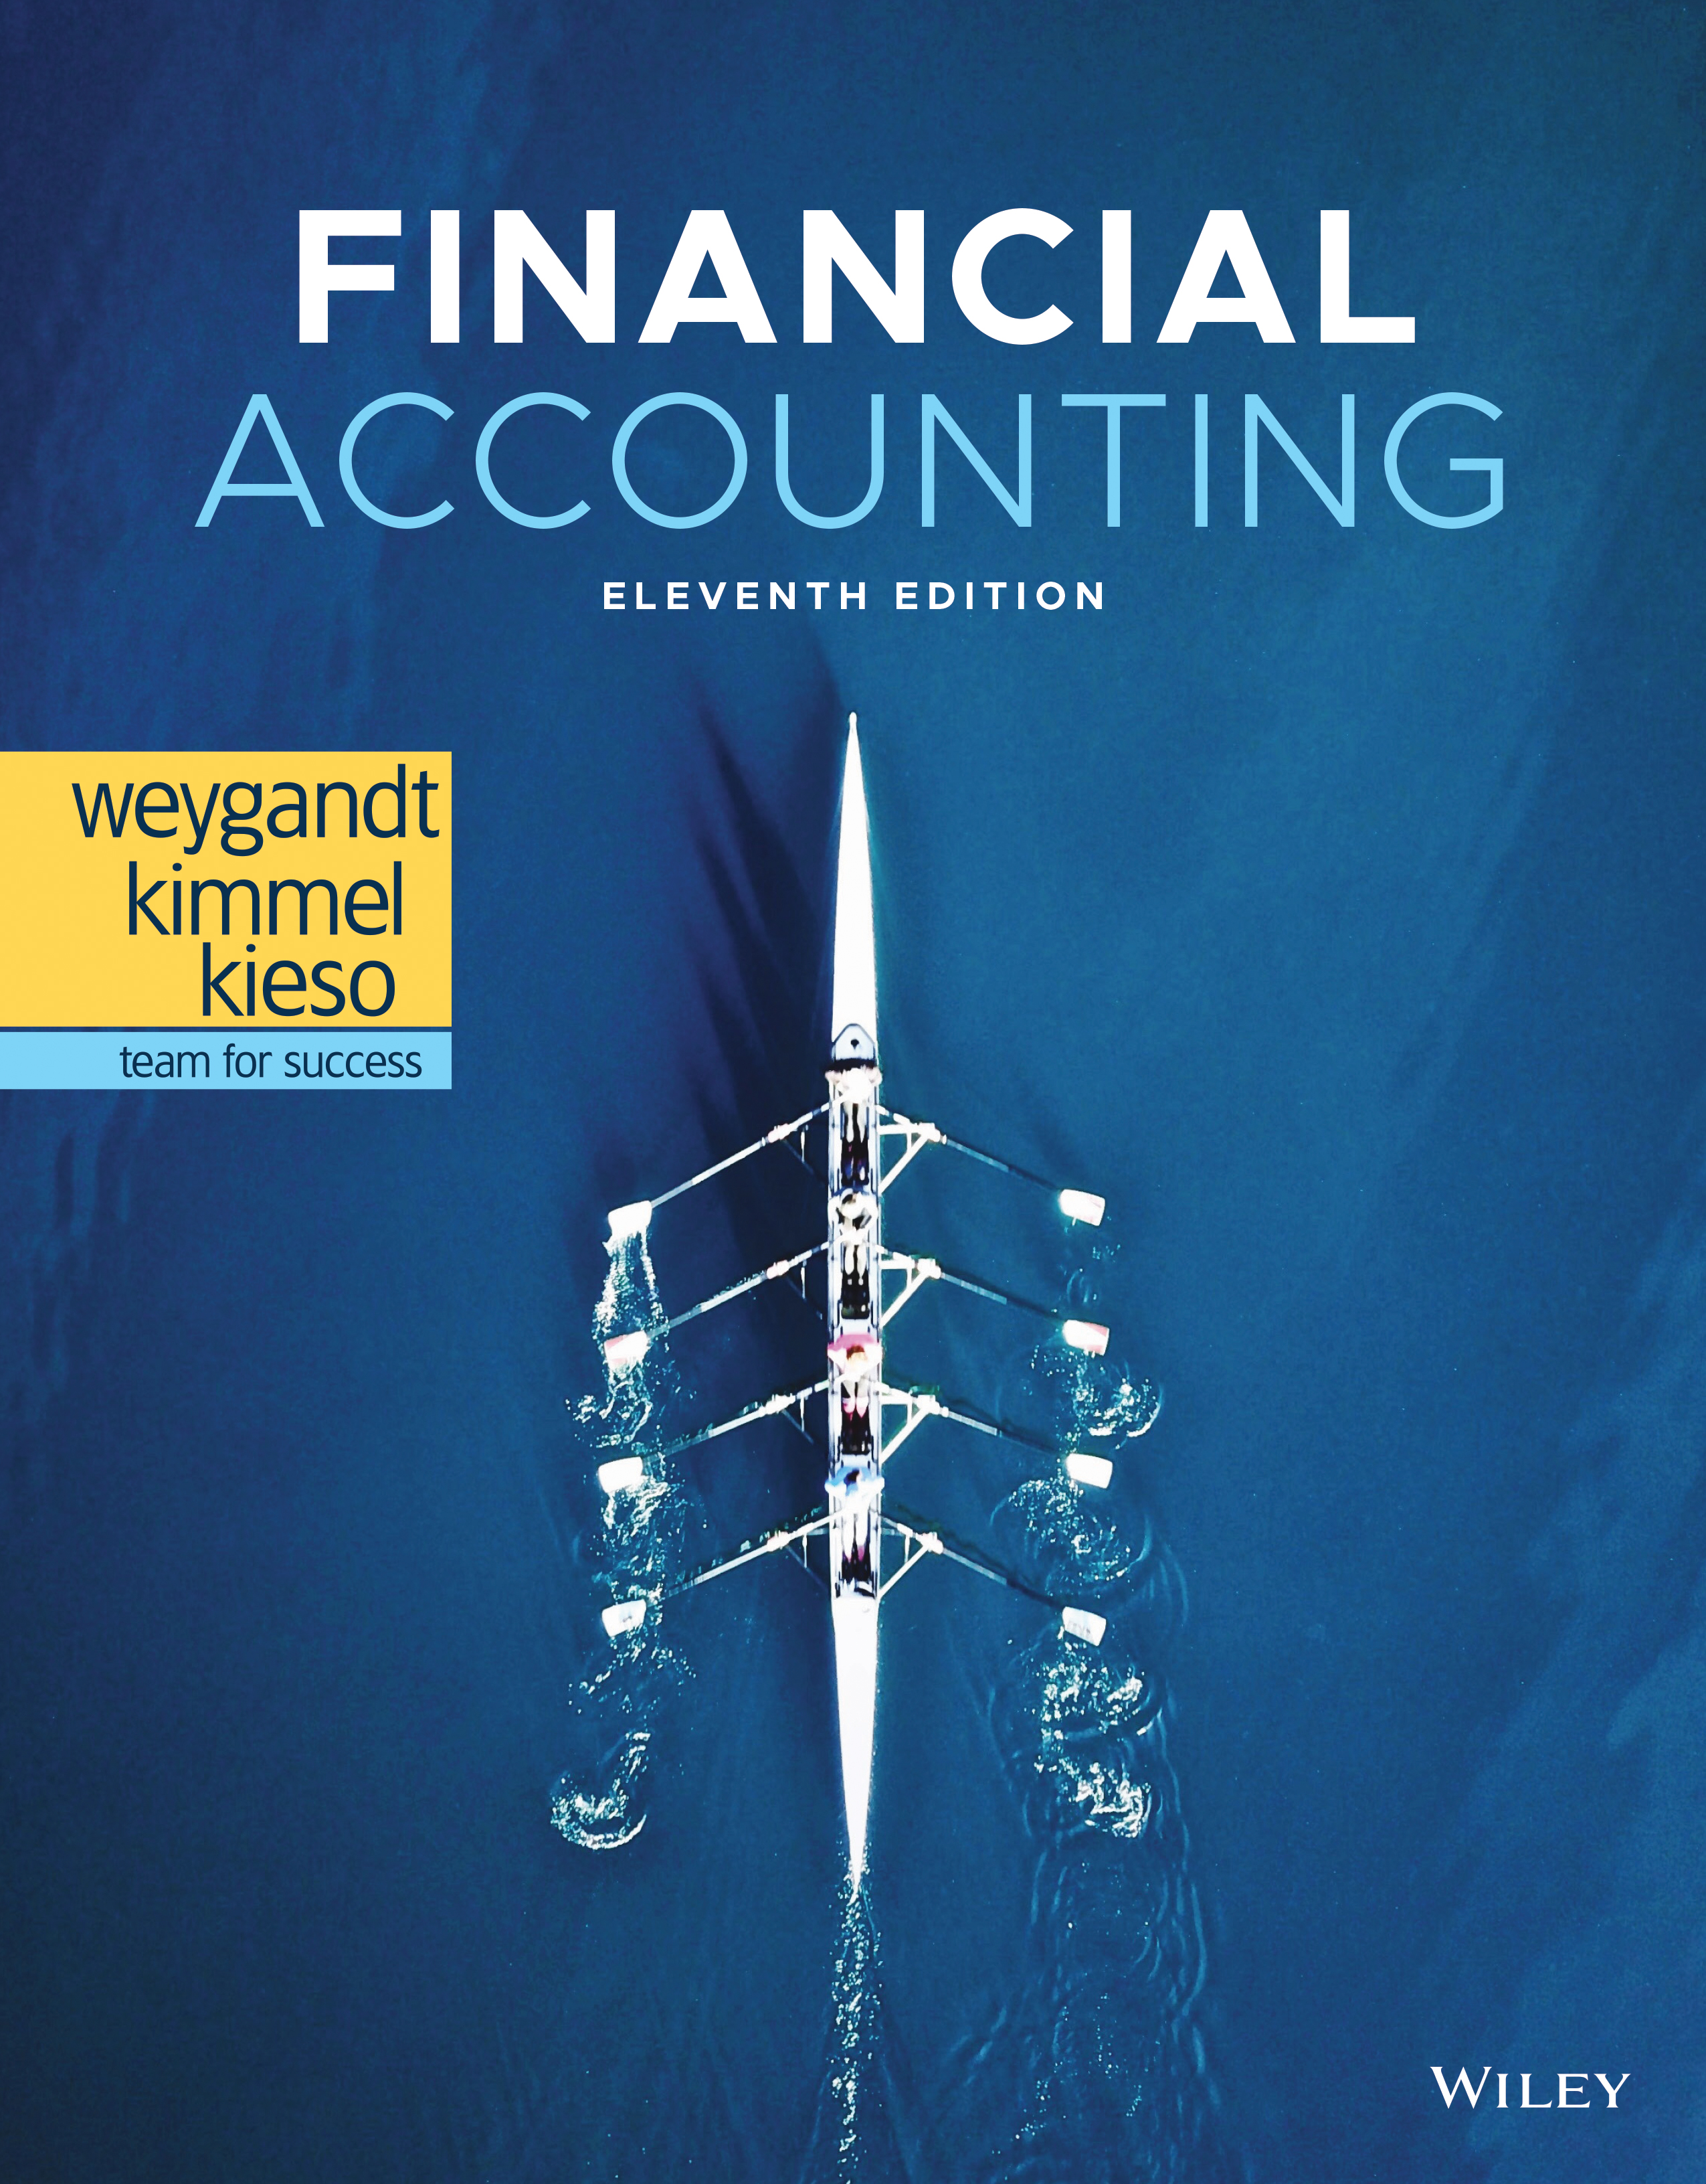
Financial Accounting

Slide 3
Completing the Accounting Cycle
Learning Objectives
L O 1 Prepare a worksheet.
L O 2 Prepare closing entries and a post-closing trial balance.
L O 3 Explain the steps in the accounting cycle and how to prepare correcting entries.
L O 4 Identify the sections of a classified balance sheet.

Slide 4
LEARNING OBJECTIVE 1 Prepare a Worksheet
Worksheet
Multiple-column spreadsheet used in preparing financial statements.
Not a permanent accounting record.
Prepared using a five-step process.
Use of worksheet is optional.
L O 1

Slide 5
Steps in Preparing a Worksheet Form and Procedure for a Worksheet
L O 1

Slide 6
Steps in Preparing a Worksheet Prepare a Trial Balance on the Worksheet
L O 1

Slide 7
Steps in Preparing a Worksheet Enter the Adjustments in the Adjustments Columns
L O 1

Slide 8
Steps in Preparing a Worksheet Complete the Adjusted Trial Balance Columns
L O 1

Slide 9
Steps in Preparing a Worksheet Extend Amounts to Financial Statement Columns
L O 1

Slide 10
Steps in Preparing a Worksheet Total Columns, Compute Net Income (Loss)
L O 1

Slide 11
Steps in Preparing a Worksheet Question
Net income is shown on a worksheet in the:
income statement debit column only.
balance sheet debit column only.
income statement credit column and balance sheet debit column.
income statement debit column and balance sheet credit column.
L O 1

Slide 12
Steps in Preparing a Worksheet Answer
Net income is shown on a worksheet in the:
income statement debit column only.
balance sheet debit column only.
income statement credit column and balance sheet debit column.
Answer: income statement debit column and balance sheet credit column.
L O 1

Slide 13
Preparing Financial Statements from a Worksheet
Income statement is prepared from the income statement columns.
Balance sheet and retained earnings statement are prepared from the balance sheet columns.
Companies can prepare financial statements before they journalize and post adjusting entries.
L O 1

Slide 14
Preparing Statements from a Worksheet Income Statement
L O 1

Slide 15
Preparing Statements from a Worksheet Retained Earnings Statement
L O 1

Slide 16
Preparing Statements from a Worksheet Balance Sheet
L O 1

Slide 17
Preparing Adjusting Entries from a Worksheet
Adjusting entries are prepared from the adjustments columns of the worksheet.
Journalizing and posting of adjusting entries follows the preparation of financial statements when a worksheet is used.
L O 1

Slide 18
DO IT! 1: Worksheet
Susan Elbe is preparing a worksheet. Explain to Susan how she should extend the following adjusted trial balance accounts to the financial statement columns of the worksheet.
Cash | Balance sheet (debit column)
Accumulated Depreciation-Equipment | Balance sheet (credit column)
Accounts Payable | Balance sheet (credit column)
Dividends | Balance sheet (debit column)
Service Revenue | Income statement (credit column)
Salaries and Wages Expense | Income statement (debit column)
L O 1

Slide 19
LEARNING OBJECTIVE 2 Prepare Closing Entries and a Post-Closing Trial Balance
At the end of the accounting period, the company makes the accounts ready for the next period.
L O 2

Slide 20
Preparing Closing Entries Purpose
Closing entries formally recognize in the ledger the transfer of
net income (or net loss) and
Dividends
to Retained Earnings.
Companies generally journalize and post closing entries only at the end of the annual accounting period.
Closing entries produce a zero balance in each temporary account.
L O 2

Slide 21
Preparing Closing Entries Diagram of Closing Process-Corporation
L O 2

Slide 22
Preparing Closing Entries Closing Entries Journalized
L O 2

Slide 23
Preparing Closing Entries Posting of Closing Entries
L O 2

Slide 24
Accounting Across the Organization Cisco Systems
Performing the Virtual Close
Technology has dramatically shortened the closing process. Recent surveys have reported that the average company now takes only 6 to 7 days to close, rather than the previous 20 days. But a few companies do much better. Cisco Systems can perform a “virtual close”—closing within 24 hours on any day in the quarter. The same is true at Lockheed Martin, which improved its closing time by 85% in just the last few years. Managers at these companies emphasize that this increased speed has not reduced the accuracy and completeness of the data.
This is not just showing off. Knowing exactly where you are financially at any time allows a company to respond faster than its competitors. It also means that the hundreds of people who used to spend 10 to 20 days each quarter tracking transactions can now be more usefully employed on other projects, such as mining data for business intelligence to find new business opportunities.
L O 2

Slide 25
Accounting Across the Organization Cisco Systems (Question and Answer)
Performing the Virtual Close
Who else benefits from a shorter closing process?
Answer:
Investors benefit from a shorter closing process. The shorter the closing, the sooner the company can report its financial results. This means that the financial information is timelier and therefore more relevant to investors.
L O 2

Slide 26
Preparing a Post-Closing Trial Balance
Purpose is to prove the equality of the permanent account balances carried forward into the next accounting period.
L O 2

Slide 27
DO IT! 2: Closing Entries
Hancock Company has the following balances in selected accounts of its adjusted trial balance.
Accounts Payable | $27,000
Service Revenue | 98,000
Rent Expense | 22,000
Supplies Expense | 7,000
Dividends | $15,000
Retained Earnings | 42,000
Accounts Receivable | 38,000
Salaries and Wages Expense | 51,000
Prepare the closing entries at December 31.
L O 2

Slide 28
DO IT! 2: Closing Entries Solution
L O 2

Slide 29
LEARNING OBJECTIVE 3 Explain the Steps in the Accounting Cycle and How to Prepare Correcting Entries
Analyze Business Transactions
Journalize the Transactions
Post to the Ledger Accounts
Prepare a Trial Balance
Journalize and Post Adjusting Entries: Deferrals/Accruals
Prepare an Adjusted Trial Balance
Prepare Financial Statements
Journalize and Post Closing Entries
Prepare a Post-Closing Trial Balance
L O 3

Slide 30
The Accounting Cycle Analyze Business Transactions
L O 3

Slide 31
The Accounting Cycle Journalize the Transactions
L O 3

Slide 32
The Accounting Cycle Post to the Ledger Accounts
L O 3

Slide 33
The Accounting Cycle Prepare a Trial Balance
L O 3

Slide 34
The Accounting Cycle Journalize and Post Adjusting Entries: Deferrals/Accruals
L O 3

Slide 35
The Accounting Cycle Prepare an Adjusted Trial Balance
L O 3

Slide 36
The Accounting Cycle Prepare Financial Statements
L O 3

Slide 37
The Accounting Cycle Journalize and Post Closing Entries
L O 3

Slide 38
The Accounting Cycle Prepare a Post-Closing Trial Balance
L O 3

Slide 39
Correcting Entries—An Avoidable Step
Unnecessary if accounting records are free of errors.
Made whenever an error is discovered.
Must be posted before closing entries.
Instead of preparing a correcting entry, it is possible to reverse the incorrect entry and then prepare the correct entry.
L O 3

Slide 40
Correcting Entries—An Avoidable Step Case 1
On May 10, Mercato Co. journalized and posted a $50 cash collection on account from a customer as a debit to Cash $50 and a credit to Service Revenue $50. The company discovered the error on May 20, when the customer paid the remaining balance in full.
L O 3

Slide 41
Correcting Entries—An Avoidable Step Case 2
On May 18, Mercato purchased on account equipment costing $450. The transaction was journalized and posted as a debit to Equipment $45 and a credit to Accounts Payable $45. The error was discovered on June 3.
L O 3

Slide 42
Accounting Across the Organization Yale Express
Lost in Transportation
Yale Express, a short-haul trucking firm, turned over much of its cargo to local truckers to complete deliveries. Yale collected the entire delivery charge. When billed by the local trucker, Yale sent payment for the final phase to the local trucker. Yale used a cutoff period of 20 days into the next accounting period in making its adjusting entries for accrued liabilities. That is, it waited 20 days to receive the local truckers’ bills to determine the amount of the unpaid but incurred delivery charges as of the balance sheet date.
On the other hand, Republic Carloading, a nationwide, long-distance freight forwarder, frequently did not receive transportation bills from truckers to whom it passed on cargo until months after the year-end. In making its year-end adjusting entries, Republic waited for months in order to include all of these outstanding transportation bills.
When Yale Express merged with Republic Carloading, Yale’s vice president employed the 20-day cutoff procedure for both firms. As a result, millions of dollars of Republic’s accrued transportation bills went unrecorded. When the company detected the error and made correcting entries, these and other errors changed a reported profit of $1.14 million into a loss of $1.88 million!
L O 3

Slide 43
Accounting Across the Organization Yale Express (Question and Answer)
Lost in Transportation
What might Yale Express’s vice president have done to produce more accurate financial statements without waiting months for Republic’s outstanding transportation bills?
Answer:
Yale's vice president could have engaged his accountants and auditors to prepare an adjusting entry based on an estimate of the outstanding transportation bills. (The estimate could have been made using past experience and the current volume of business.)
L O 3

Slide 44
DO IT! 3: Correcting Entries Information
Sanchez Company discovered the following errors made in January 2022.
A payment of Salaries and Wages Expense of $600 was debited to Supplies and credited to Cash, both for $600.
A collection of $3,000 from a client on account was debited to Cash $200 and credited to Service Revenue $200.
The purchase of supplies on account for $860 was debited to Supplies $680 and credited to Accounts Payable $680.
Correct the errors without reversing the incorrect entry.
L O 3

Slide 45
DO IT! 3: Correcting Entries Payment of Salaries Error
Sanchez Company discovered the following errors made in January 2022.
A payment of Salaries and Wages Expense of $600 was debited to Supplies and credited to Cash, both for $600.
Correct the error without reversing the incorrect entry.
Salaries and Wages Expense | 600
Supplies |  | 600
L O 3

Slide 46
DO IT! 3: Correcting Entries Collection on Account Error
Sanchez Company discovered the following errors made in January 2022.
A collection of $3,000 from a client on account was debited to Cash $200 and credited to Service Revenue $200.
Correct the error without reversing the incorrect entry.
Service Revenue | 200
Cash | 2,800
Accounts Receivable |  | 3,000
L O 3

Slide 47
DO IT! 3: Correcting Entries Purchase of Supplies on Account Error
Sanchez Company discovered the following errors made in January 2022.
The purchase of supplies on account for $860 was debited to Supplies $680 and credited to Accounts Payable $680.
Correct the error without reversing the incorrect entry.
Supplies ($860 − $680) | 180
Accounts Payable |  | 180
L O 3

Slide 48
LEARNING OBJECTIVE 4 Identify the Sections of a Classified Balance Sheet
Presents a snapshot at a point in time.
To improve understanding, companies group similar assets and similar liabilities together.
Standard Classifications
Assets | Liabilities and Stockholders’ Equity
Current assets | Current liabilities
Long-term investments | Long-term liabilities
Property, plant, and equipment | Stockholders’ equity
Intangible assets
L O 4

Slide 49
Identify the Sections of a Classified Balance Sheet Assets
L O 4

Slide 50
Identify the Sections of a Classified Balance Sheet Liabilities and Stockholders’ Equity
L O 4

Slide 51
Current Assets
Assets that a company expects to convert to cash or use up within one year or its operating cycle, whichever is longer.
Operating cycle is the average time that it takes to purchase inventory, sell it on account, and then collect cash from customers.
L O 4

Slide 52
Current Assets Example
Usually listed in the order they expect to convert them into cash.
L O 4

Slide 53
Current Assets Question
The correct order of presentation in a classified balance sheet for the following current assets is:
accounts receivable, cash, prepaid insurance, inventory.
cash, inventory, accounts receivable, prepaid insurance.
cash, accounts receivable, inventory, prepaid insurance.
inventory, cash, accounts receivable, prepaid insurance.
L O 4

Slide 54
Current Assets Answer
The correct order of presentation in a classified balance sheet for the following current assets is:
accounts receivable, cash, prepaid insurance, inventory.
cash, inventory, accounts receivable, prepaid insurance.
Answer: cash, accounts receivable, inventory, prepaid insurance.
inventory, cash, accounts receivable, prepaid insurance.
L O 4

Slide 55
Long-Term Investments
Investments in stocks and bonds of other companies.
Investments in long-term assets such as land or buildings that are not currently being used in operating activities.
Long-term notes receivable.
L O 4

Slide 56
Property, Plant, and Equipment
Long useful lives.
Currently used in operations.
Depreciation - allocating the cost of assets to a number of years.
Accumulated depreciation - total amount of depreciation expensed thus far in the asset’s life.
Alternative Terminology
Property, plant, and equipment is sometimes called fixed assets or plant assets.
L O 4

Slide 57
Property, Plant, and Equipment Example
L O 4

Slide 58
Intangible Assets
Long-lived assets that do not have physical substance.
L O 4

Slide 59
The Classified Balance Sheet Question
Patents and copyrights are
Current assets.
Intangible assets.
Long-term investments.
Property, plant, and equipment.
L O 4

Slide 60
The Classified Balance Sheet Answer
Patents and copyrights are
Current assets.
Answer: Intangible assets.
Long-term investments.
Property, plant, and equipment.
L O 4

Slide 61
People, Planet, and Profit Insight
Regaining Goodwill
After falling to unforeseen lows amidst scandals, recalls, and economic crises, the reputation of corporate America is recovering in the eyes of the American public. Overall corporate reputation is experiencing rehabilitation as the American public gives high marks overall to corporate America, specific industries, and the largest number of individual companies in a dozen years. This is according to the findings of the 2011 Harris Interactive RQ Study, which measures the reputations of the 60 most visible companies in the United States.
The survey focuses on six reputational dimensions that influence reputation and consumer behavior. Four of these dimensions, along with the five corporations that ranked highest within each, are as follows.
Social Responsibility: (1) Whole Foods Market, (2) Johnson & Johnson, (3) Google, (4) The Walt Disney Company, (5) Procter & Gamble Co.
Emotional Appeal: (1) Johnson & Johnson, (2) Amazon.com, (3) UPS, (4) General Mills, (5) Kraft Foods
Financial Performance: (1) Google, (2) Berkshire Hathaway, (3) Apple, (4) Intel, (5) The Walt Disney Company
Products and Services: (1) Intel Corporation, (2) 3M Company, (3) Johnson & Johnson, (4) Google, (5) Procter & Gamble Co.
Source: www.harrisinteractive.com
L O 4

Slide 62
People, Planet, and Profit Insight (Continued)
Regaining Goodwill
Name two industries today that are probably rated low on the reputational characteristics of “being trusted” and “having high ethical standards.”
Two possible industries are financial companies (Goldman Sachs or AIG) or oil companies (BP).
L O 4

Slide 63
Current Liabilities
Obligations the company is to pay within the coming year or its operating cycle, whichever is longer.
Usually list notes payable first, followed by accounts payable. Other items follow in order of magnitude.
Common examples are accounts payable, salaries and wages payable, notes payable, interest payable, income taxes payable, and current maturities of long-term obligations.
Liquidity - ability to pay obligations expected to be due within the next year.
L O 4

Slide 64
Current Liabilities Example
L O 4

Slide 65
Accounting Across the Organization REL Consultancy Group
Can a Company Be Too Liquid?
There actually is a point where a company can be too liquid—that is, it can have too much working capital (current assets less current liabilities). While it is important to be liquid enough to be able to pay short-term bills as they come due, a company does not want to tie up its cash in extra inventory or receivables that are not earning the company money.
By one estimate from the REL Consultancy Group, the thousand largest U.S. companies have on their books cumulative excess working capital of $764 billion. Based on this figure, companies could have reduced debt by 36% or increased net income by 9%. Given that managers throughout a company are interested in improving profitability, it is clear that they should have an eye toward managing working capital. They need to aim for a “Goldilocks solution”—not too much, not too little, but just right.
Source: K. Richardson, “Companies Fall Behind in Cash Management,” Wall Street Journal (June 19, 2007).
L O 4

Slide 66
Accounting Across the Organization REL Consultancy Group (Continued)
Can a Company Be Too Liquid?
What can various company managers do to ensure that working capital is managed efficiently to maximize net income?
Answer:
Marketing and sales managers must understand that by extending generous repayment terms, they are expanding the company's receivables balance and slowing the company's cash flow. Production managers must strive to minimize the amount of excess inventory on hand. Managers must coordinate efforts to speed up the collection of receivables, while also ensuring that the company pays its payables on time but never too early.
LO 4

Slide 67
Long-Term Liabilities
Obligations a company expects to pay after one year.
L O 4

Slide 68
The Classified Balance Sheet Question (Continued)
Which of the following is not a long-term liability?
Bonds payable
Current maturities of long-term obligations
Long-term notes payable
Mortgage payable
L O 4

Slide 69
The Classified Balance Sheet Answer (Continued)
Which of the following is not a long-term liability?
Bonds payable
Answer: Current maturities of long-term obligations
Long-term notes payable
Mortgage payable
L O 4

Slide 70
Stockholders’ (Owners’) Equity
Proprietorship - one capital account.
Partnership - capital account for each partner.
Corporation - Common Stock and Retained Earnings.
L O 4

Slide 71
DO IT! 4: Balance Sheet Classifications
The following accounts were taken from the financial statements of Callahan Company.
Match each of the following accounts to its proper balance sheet classification, shown below. If the item would not appear on a balance sheet, use “NA.”
Current assets (CA) | Current liabilities (CL)
Long-term investments (LTI) | Long-term liabilities (LTL)
Property, plant, and equipment (PPE) | Stockholders’ equity (SE)
Intangible assets (IA)
L O 4

Slide 72
DO IT! 4: Balance Sheet Classifications Solution
The following accounts were taken from the financial statements of Callahan Company.
Match each of the following accounts to its proper balance sheet classification, shown below. If the item would not appear on a balance sheet, use “NA.”
Current assets (CA) | Current liabilities (CL)
Long-term investments (LTI) | Long-term liabilities (LTL)
Property, plant, and equipment (PPE) | Stockholders’ equity (SE)
Intangible assets (IA)
L O 4

Slide 73
LEARNING OBJECTIVE 5 Appendix 4A: Prepare Reversing Entries
Reversing Entries
It is often helpful to reverse some of the adjusting entries before recording the regular transactions of the next period.
Companies make a reversing entry at the beginning of the next accounting period.
Each reversing entry is the exact opposite of the adjusting entry made in the previous period.
The use of reversing entries does not change the amounts reported in the financial statements.
L O 5

Slide 74
Reversing Entries Example
Illustration: To illustrate the optional use of reversing entries for accrued expenses, we will use the salaries expense transactions for Pioneer Advertising Inc.
October 26 (initial salary entry): Pioneer pays $4,000 of salaries and wages earned between October 15 and October 26.
October 31 (adjusting entry): Salaries and wages earned between October 29 and October 31 are $1,200. The company will pay these in the November 9 payroll.
November 9 (subsequent salary entry): Salaries and wages paid are $4,000. Of this amount, $1,200 applied to accrued salaries and wages payable, and $2,800 was earned between November 1 and November 9.
L O 5

Slide 75
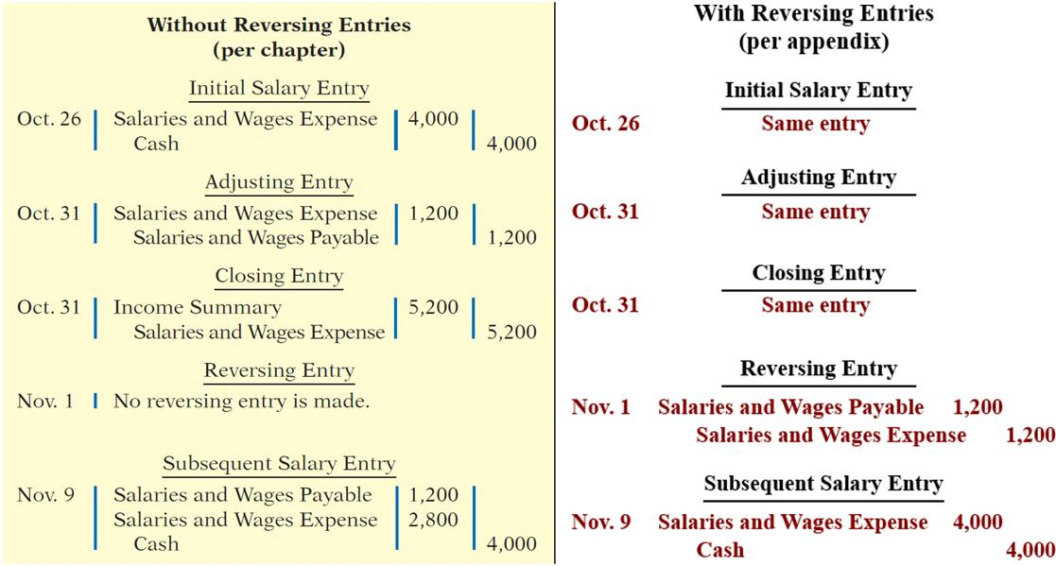
Reversing Entries Example Comparative Entries-Without and With Reversing
L O 5

Slide 76
Reversing Entries Example Posting with Reversing Entries
L O 5

Slide 77
A Look at I F R S Similarities
L O 6 Compare the procedures for the closing process under G A A P and
I F R S
Similarities
The procedures of the closing process are applicable to all companies, whether they are using I F R S or G A A P.
I F R S generally requires a classified statement of financial position similar to the classified balance sheet under G A A P.
I F R S follows the same guidelines as this text for distinguishing between current and noncurrent assets and liabilities.
L O 6

Slide 78
A Look at I F R S Differences
Differences
I F R S recommends but does not require the use of the title “statement of financial position” rather than “balance sheet”.
The format of statement of financial position information is often presented differently under I F R S. Although no specific format is required, many companies that follow I F R S present statement of financial position information in this order:
Non-current assets
Current assets
Equity
Non-current liabilities
Current liabilities
L O 6

Slide 79
A Look at I F R S More Differences
Key Points
More Differences
Under I F R S, current assets are usually listed in the reverse order of liquidity. For example, under G A A P cash is listed first, but under I F R S it is listed last.
Both G A A P and I F R S are increasing the use of fair value to report assets. However, at this point I F R S has adopted it more broadly. As examples, under I F R S companies can apply fair value to property, plant, and equipment, and in some cases intangible assets.
L O 6

Slide 80
A Look at I F R S Land Question
I F R S Self-Test Questions
A company has purchased a tract of land and expects to build a production plant on the land in approximately 5 years. During the 5 years before construction, the land will be idle. Under I F R S, the land should be reported as:
land expense.
property, plant, and equipment.
an intangible asset.
a long-term investment.
L O 6

Slide 81
A Look at I F R S Land Answer
I F R S Self-Test Questions
A company has purchased a tract of land and expects to build a production plant on the land in approximately 5 years. During the 5 years before construction, the land will be idle. Under IFRS, the land should be reported as:
land expense.
property, plant, and equipment.
an intangible asset.
Answer: a long-term investment.
L O 6

Slide 82
A Look at I F R S Current Assets Question
I F R S Self-Test Questions
Current assets under I F R S are listed generally:
by importance.
in the reverse order of their expected conversion to cash.
by longevity.
alphabetically.
L O 6

Slide 83
A Look at I F R S Current Assets Answer
I F R S Self-Test Questions
Current assets under I F R S are listed generally:
by importance.
Answer: in the reverse order of their expected conversion to cash.
by longevity.
alphabetically.
L O 6

Slide 84
A Look at I F R S State. of Fin. Pos. Question
I F R S Self-Test Questions
Companies that follow I F R S:
use the term stock instead of shares for investments.
may offset assets against liabilities and show net assets and net liabilities on their statements of financial position, rather than the underlying detailed line items.
may report non-current assets before current assets on the statement of financial position.
do not have any guidelines as to what should be reported on the statement of financial position.
L O 6

Slide 85
A Look at I F R S State. of Fin. Pos. Answer
I F R S Self-Test Questions
Companies that follow I F R S:
use the term stock instead of shares for investments.
may offset assets against liabilities and show net assets and net liabilities on their statements of financial position, rather than the underlying detailed line items.
Answer: may report non-current assets before current assets on the statement of financial position.
do not have any guidelines as to what should be reported on the statement of financial position.
L O 6

Slide 86
Copyright
©2020 John Wiley & Sons, Inc. All rights reserved.
No part of this publication may be reproduced, stored in a retrieval system, or transmitted, in any form or by any means, electronic, mechanical, photocopying, recording or otherwise, except as permitted by law. Advice on how to obtain permission to reuse this material is available at http://www.wiley.com/go/permissions.

